Slide 1


Objectives
In this session, you will learn to:
  Use variables, operators, and control structures
  Implement functions

Slide 2
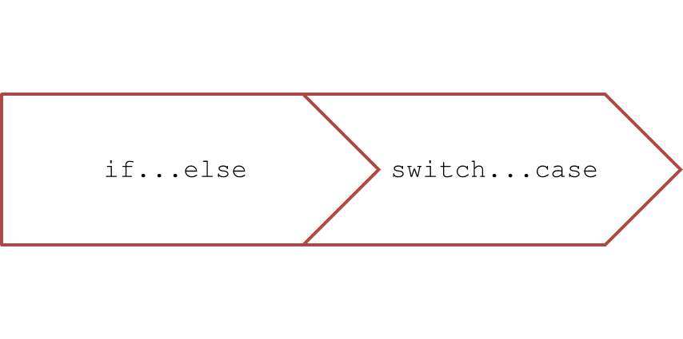
Using Conditional Constructs
Conditional constructs:
  Allow you to execute a block of statements based on the result of the expression being
  evaluated.
  Can be of the following types:

Slide 3
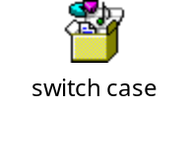
Using Conditional Constructs (Contd.)
The if…else construct:
  Is used to evaluate the specified condition and perform actions on the basis of
  the result of evaluation.
  Has the following syntax:
    if (exp)
    {
    // Statements;
    }
    else
    {
    // Statements;
    }
The switch…case construct is used when you need to evaluate a variable
for multiple values.
  The following embedded Notepad file contains the code to understand the use of
  switch…case construct in HTML:

Slide 4
Using Loop Constructs
Loop structures:
  Are used to repeatedly execute one or more lines of code.
  Can be of the following types:
while
do...while
for

Slide 5
Using Loop Constructs (Contd.)
The while loop:
  Is used to repeatedly execute a block of statements till a condition evaluates to true.
  Always checks the condition before executing the statements in the loop.
  Has the following syntax:
    while (expression)
    {
    statements;
    }

Slide 6
Using Loop Constructs (Contd.)
The do…while loop:
  Is executed at least once, even if the condition evaluates to false.
  Has the following syntax:
    do
    { Statements;
    }
    while(condition)

Slide 7
Using Loop Constructs (Contd.)
The for loop:
  Allows the execution of a block of code depending on the result of the evaluation of the
  test condition.
  Has the following syntax:
    for (initialize variable; test condition; step value)
    {
    // code block
    }

Slide 8
Break and Continue Statements
The break statement:
  Is used to exit the loop.
  Prevents the execution of the remaining statements of the loop.
  Is usually placed within an if construct inside the loop.
The continue statement:
  Is used to skip all the subsequent instructions and take the control back to the
  beginning of the loop.

Slide 9
Implementing Functions
Functions are used to write the code that needs to reused.
They optimize the performance of the code.

Slide 10
Introducing Functions
Functions:
  Are a self-contained block of statements that have a name.
  Are of the following types:
Built-in
User-defined

Slide 11
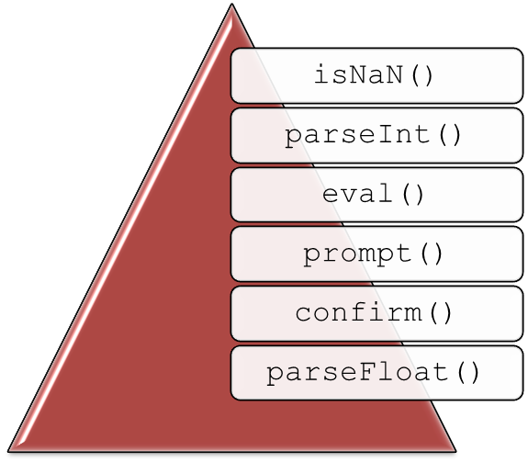
Introducing Functions (Contd.)
Built-in functions:
  Are ready to use as they are already coded.
  For example:
User-defined functions:
  Are defined according to the need of the user.

Slide 12
Creating Functions
Functions:
  Are created by using the keyword, function, followed by the function name
  and the parentheses.
  Are normally defined in the head section of a Web page.
  Can optionally accept a list of parameters.
  Are created using the following syntax:
    function [functionName] (Variable1, Variable2)
    {
    //function statements
    }

Slide 13
Accessing Functions
A function is called by using the following syntax:
functionName ();
or
functionName (parameter1, parameter 2...);
A function returns a value by using the return statement as displayed in
the following example:
  function functionName()
  {
  var variable=10;
  return variable;
  }

Slide 14
Just a Minute
Which one of the following functions is used to take input from a user?
  alert()
  prompt()
  isNaN()
  confirm()

Slide 15
Just a Minute (Contd.)
Solution:
  prompt()

Slide 16
Demo: Implementing Functions
Problem Statement:
  MathTutor.com is a leading online tutorial website for Mathematics. It provides
  tutorial content for different age groups. The Web designer of the website is given
  a task to develop a Web page for the students in the age group of 5-10 years.
  The Web page should ask the students to provide a number up to which they want
  to view prime numbers. It should enable the students to view prime numbers up to
  100. Help the Web designer to achieve the task.

Slide 17
Demo: Implementing Functions (Contd.)
Solution:
  To create a Web page to view prime numbers, you need to perform the following tasks:
    1. Create the prime.html file.
    2. View the prime.html file.

Slide 18
Summary
In this session, you learned that:
  In JavaScript, the following conditional constructs can be used:
    if...else
    switch...case
  In JavaScript, the following loop structures can be used:
    while
    do...while
    for
  A function is a self-contained block of statements that has a name.
  Some of the built-in functions supported by JavaScript are:
    isNaN()
    parseInt()
    parseFloat()
    eval()
    prompt()
    confirm()
  Functions are created by using the keyword, function, followed by the function name and the parentheses.
  Functions can return a value using the return statement.

